Slide 1
Chapter 1: Structure and Bonding

Slide 2
Outline
Introduction
Structure of the atom
Electron orbitals and configurations
Chemical bonding
Valence bond theory
Molecular orbital theory
Hybridization
Drawing molecules

Slide 3
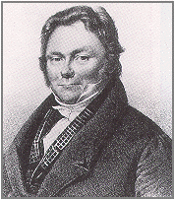
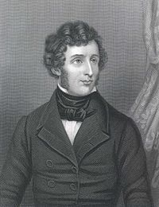
What is Organic Chemistry?
Organic chemistry originally meant chemistry of life
Jöns Jacob Berzelius coined the term “organic chemistry” in 1807
Vital force theory
Friedrich Wöhler synthesized urea in 1828 from inorganic sources

Slide 4
Modern Organic Chemistry
The chemistry of molecules that contain both carbon and hydrogen
Carbon but no hydrogen is inorganic
Hydrogen but no carbon is inorganic
Only compounds containing both are considered organic

Slide 5
Organic Compounds
There are over 10 million known organic molecules
Some are synthetic

Slide 6
Organic Compounds
There are over 10 million known organic molecules
Some are synthetic
Others are natural compounds

Slide 7
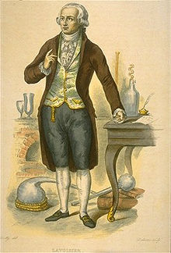
Carbon
Carbon
First identified as an element in 1789
Named after carbo Lt. “coal”
Nature of carbon atoms
4 Covalent bonds
Medium electronegativity
Forms a variety of structures

Slide 8
Structure of Molecules
Organic compounds are made up of atoms
Atoms are chemically bonded together to form molecules
The nature of the atoms determine a molecule’s properties
Organic reactions involve breaking or forming atomic bonds
Understanding atomic structure is key to understanding organic molecules

Slide 9
Properties of Atoms
Atomic structure
Positively charged nucleus
Negatively charged electrons
Individual atoms are overall neutral
Ions are an exception
Jöns Jakob Berzelius also first proposed the idea that atoms carry an electric charge.

Slide 10
Atomic Nucleus
All of an atom’s mass is contained in the nucleus
Nuclei contain protons and neutrons
The number of protons determines the atoms atomic number
Different numbers of neutrons create isotopes with differing masses
Examples of isotopes

Slide 11
Atomic Orbitals
Electrons orbit nuclei in an area called an electron cloud
Shapes are determined mathematically through wavefunctions
Less of a defined flight path and more of an area of probability
Produces a cloud of negative charge

Slide 12
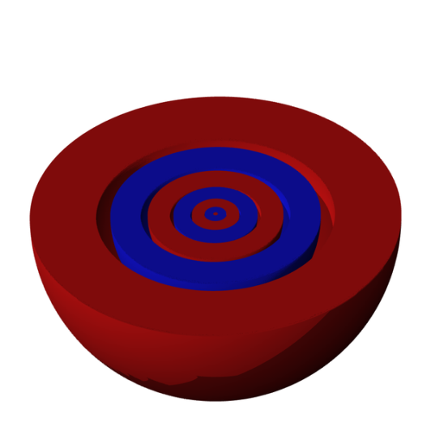
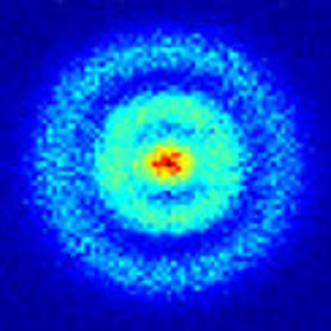
Atomic Orbitals
4 orbitals (s,p,d,f)
Arranged in shells (1,2,3,etc) containing an increasing number of orbitals
Shells increase in size
Organic chemistry is primarily concerned with s and p orbital interactions
The first photograph of a hydrogen atom was taken in May, 2013
Several s orbital shells layering together. Note that each shell is empty in the center..

Slide 13
Atomic Orbitals
s Orbital
Group 1A and 2A elements

Slide 14
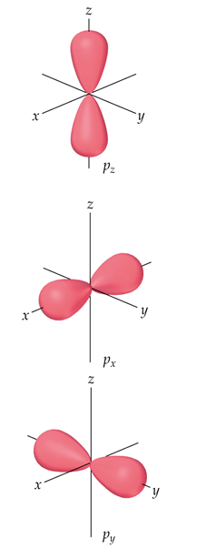
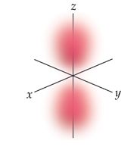
Atomic Orbitals
P Orbitals
Group 3A-8A elements

Slide 15
Electron Configurations
Electrons in an atom occupy specific shells and orbitals
Written as a series of filled orbitals
Electrons take the lowest energy arrangement
Ground-state electron configuration
Higher energy electron arrangements exists, but require an influx of energy
The arrangement of all electrons around an atom determines its properties
Notes:
Rerecord

Slide 16
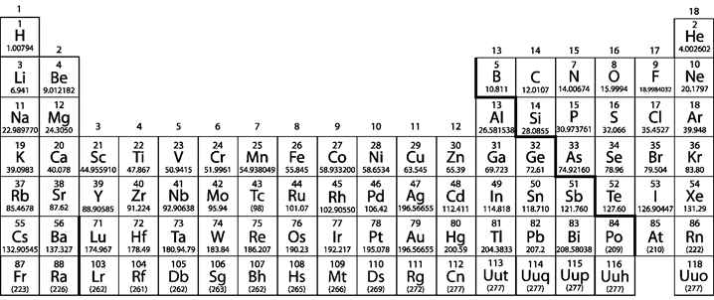
Aufbau Principle
From German for “building-up”
Lowest energy orbitals fill first
The periodic table is arranged to reflect the filling of electron orbitals

Slide 17
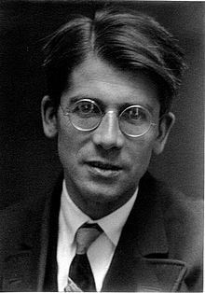
Hund’s Rule
Electrons exert a repulsive force on each other
Electrons with the same spin fill all unoccupied orbitals first
Half-filled orbitals are preferred and stable
Higher spin state forces electrons to double up
Freidrich Hund published over 250 papers on quantum theory.
He is most recognized for his contributions in describing the structure of the atom.

Slide 18
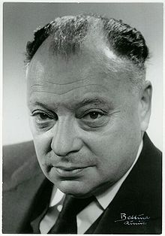
Pauli Exclusion Principle
Electrons rotate around an axis
Produces a spin magnetic moment
Magnitude of ½ and direction either “up” or “down” direction
No two electrons with the same spin may occupy the same orbital
Wolfgang Pauli was awarded the Nobel Prize in physics for his pioneering work in quantum physics.

Slide 19
Filling Electron Shells
Start with nearest noble gas in []
[He], [Ne], etc
Fill with the period’s s shell first
Continue to fill according to Aufbau Principle
C P S²⁻

Slide 20
Filling Electron Shells
Give the following electron configuration
I⁻ Si

Slide 21
Quantum Numbers
An electron’s position in an atomic orbital is defined by its quantum number
n = Principle quantum number (1, 2, 3, etc)
l = Angular quantum number (0, 1, 2…n-1)
m_{l} = Magnetic quantum number (-l, -l+1…0…l-1, l)
m_{s} = Spin projection quantum number (+/-½)

Slide 22
Example: Oxygen
Oxygen has two shells n=1, and n=2
n = 1
l =
m_{l} =
m_{s} =
n = 2
l =
m_{l} =
m_{s} =
l =
m_{l} =
m_{s} =
Notes:
Rerecord n=2

Slide 23
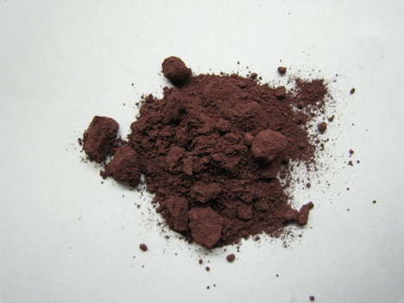
Quantum Numbers and Electron Shells
P
Because some forms of phosphorous glow upon exposure to air, its was named “light-bringer” in Greek.

Slide 24
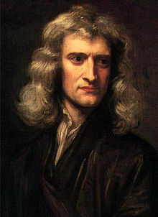
Chemical Bonding
Molecules are formed when individual atoms are attracted together
Interactions between atoms are called chemical bonds
Chemical bonds are more stable than the individual atoms
Less energy than individual atoms
Energy is required to break bonds
Sir Isaac Newton first proposed a force holding atoms together in 1704. It would be over 200 years before chemical bonds were properly described.

Slide 25
Chemical Bonding

Slide 26
Valencey
Atoms form a predictable number of bonds
The ‘valency’ of the atom (Lt. ‘capacity’ or ‘strength’)
Electrons in the outermost shell are valence electrons
These are the electrons involved in or available for bonding

Slide 27
Valence Bond Theory
Covalent bonds form through the interaction of valence electrons
Bond Formation

Slide 28
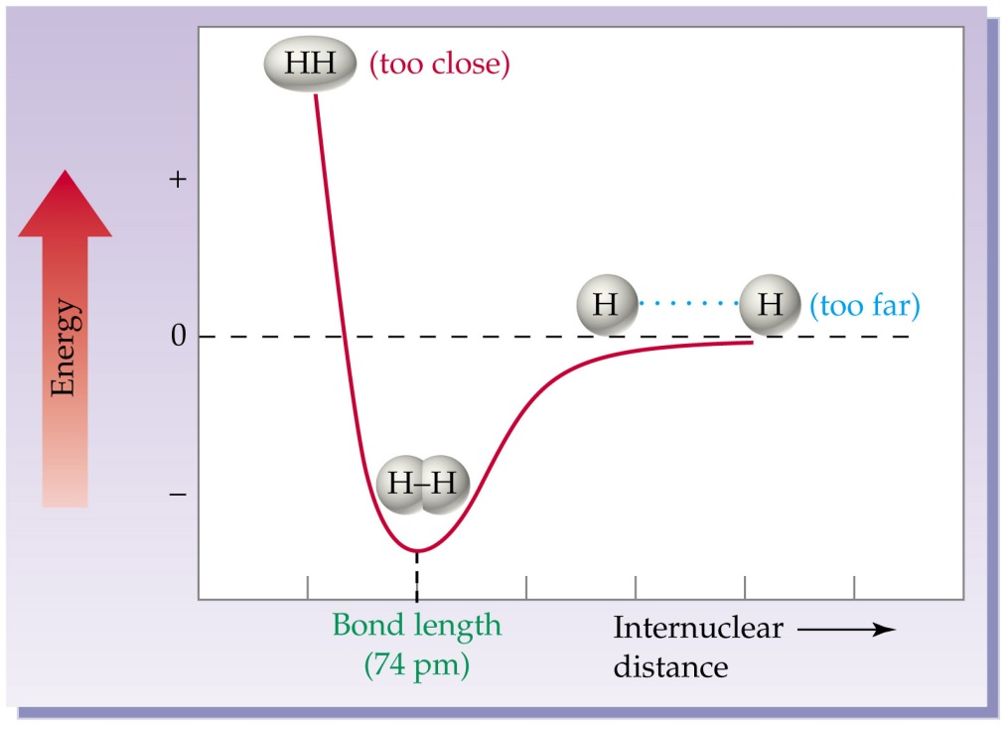
Energy Diagram
Energy of a bond
At long distances
At bonding distance
At close distances
Bonding Distance

Slide 29
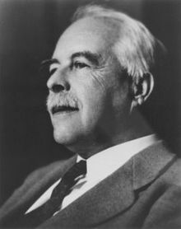
Lewis Dot Structures
A method for drawing chemical bonds
Dots represent the valence shell electrons
Stable molecules have noble gas configurations
Electrons between atoms represent bonds
G. N. Lewis first proposed that bonds formed from the sharing of unpaired electrons in 1917. This was the basis for his design of Lewis dot structures.

Slide 30
Lewis Dot Structures
Begin by drawing valence electrons
Combine the atoms so that each contributes one electron to the bond
If an octet is incomplete, share additional atoms between atoms
Add or subtract elections of ions equal to the charge

Slide 31
Lewis Dot Structures
Exceptions to the octet rule
IA and IIA elements
IIIA elements
Metals, sulfur, and phosphorous

Slide 32
Lewis Dot Structures
NH₃ COH₂ N₃⁻

Slide 33
Molecular Orbital Theory (MOT)
MOT describes molecular bonds as wavefunctions like atomic orbitals
Bonds act as molecular orbitals
Atomic orbitals overlap to form molecular orbitals
Can overlap in many ways to from different shapes & energy levels
Molecular orbital of a hydrogen molecule

Slide 34
Molecular Orbital Theory (MOT)
MOT explains why H₂ is stable, but He₂ is not
Molecular orbital of a hydrogen molecule
Molecular orbital of a helium molecule

Slide 35
Nature of Chemical Bonds
Both theories describe molecular bonds
Valence bond theory
Molecular orbital theory
Neither theory is 100% correct
Which is more correct is disputed
Sometimes 1 theory is better than another
Depends on situation being described

Slide 36
Nature of Chemical Bonds
Chemical bonds have specific lengths
Bond length is the distance between the two nuclei
Chemical bonds have specific bond angle
Both are important in the stability of a chemical bond

Slide 37
Types of Chemical Bonds
σ Bonds
All covalent bonds have 1 σ bond
Makes up the ‘skeleton’ of a molecule
π Bonds

Slide 38
The H₂ Molecule
Bond length of
Bond strength of
Bond formed through the overlap of two head-on orbitals

Slide 39
Hybrid Orbitals
Most molecules cannot be explained through simple s and p orbital interactions
By combining together orbitals become more accessible and better suited for bonding

Slide 40
Hybridization: sp³ Orbitals
Linus Pauling showed that 1 s and 3 p orbitals can hybridize into 4 sp³ orbitals
Arranged symmetrically around the nucleus
Provides the tetrahedral structure 4 C bonds form
Hybridization is energetically favored

Slide 41
Methane, a sp³ carbon
CH₄ Carbon has 4 orbitals with sp³ hybridization
Tetrahedral shape
H-C-H bond angle of
Bond length of
Bond strength of

Slide 42
Ethane: sp³-sp³ Bonding
Both carbons are sp³ hybridized
Bonds still form head-on orbital overlap
C-H bonds
C-C bonds
C-H-H bond angle of
C-C-H bond angle of

Slide 43
sp² Hybridization
1 s and 2 p orbitals hybridize to form sp² orbitals
Contains
shape
Increased s character

Slide 44
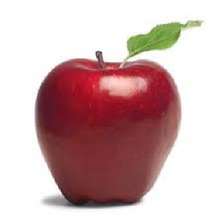
Ethylene: C-C Double Bonds
Unhybridized p orbitals are capable of forming π bonds
A σ and a π bond form a double bond
Molecules are trigonal planar shaped
C-C double bond
H-C-H bond angle
C-C-H bond angle
Ethylene is a naturally occurring plant hormone that causes fruit to ripen.

Slide 45
sp Hybridization
1 s and 1 p orbitals hybridize to form 2 sp orbitals
Contains 2 unhybridized p orbitals
shape
Increased s character
Triple bond or 2 double bonds

Slide 46
Acetylene: C-C Triple Bonds
Unhybridized p orbitals form 2 π bonds
A σ and 2 π bonds together form a triple bond
Acetylene - a C-C triple bond

Slide 47
Carbon Hybridization

Slide 48
Hybridization of non-C Atoms
Nitrogen
Nitrogen contains 1 lone pair
Acts the same as a bonded orbital
shape
Similar bond angles to tetrahedron
Hybridizes similar to carbon

Slide 49
Hybridization of non-C Atoms
Oxygen
Oxygen contains 2 lone pairs
shape
planar

Slide 50
Hybridization of non-C Atoms
Phosphorous and Sulfur
Analogous to elements above them
3rd row elements can access d orbitals
Normally empty

Slide 51
Hybridization of non-C Atoms
Phosphorous
Analogous to nitrogen
Phosphites are hybridized
Phosphoranes, PR₅

Slide 52
Hybridization of non-C Atoms
Organophosphates, PO₄R₃
sp³
σ bonds, π bond
Tetrahedral shape
ATP

Slide 53
Hybridization of non-C Atoms
Sulfur
Analogous to oxygen
Prefers hybridization
Types of sulfur molecules
hybridization
hybridization
Additional hybridizations

Slide 54
Drawing Molecules
Chemical formulas tell what’s in a molecule, not its structure
C₅H₁₂ can be drawn multiple ways
Condensed structures are a written way of describing molecules
CH₃,CH₂, CH, and C describe the carbon skeleton
Divergent structures are in () after the carbon they are attached to

Slide 55
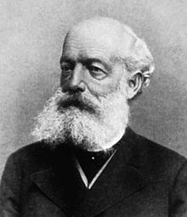
Drawing Molecules
Kekulé or skeletal structures
Uses lines to depict molecules
Carbons are at the intersection or end of lines
Hydrogens attached to carbons are generally omitted
Hydrogens attached to non-carbon atoms are always shown
The exception is when a H has stereochemistry
Any other atoms are always shown
Lone pairs are generally not shown unless participating in a reaction
August Kekulé was the founder of the theory of chemical structure. He was the first to correctly elucidate the structure of benzene.

Slide 56
Drawing Molecules
Stereochemistry
Molecules are 3D objects, not flat
Drawing molecules must reflect the 3D shape
All ‘flat’ lines are considered
Other atoms are drawn coming towards or away from the viewer

Slide 57
Drawing Molecules
Draw HSC(CH₃)₂CH(NH₂)C(O)OH as:
Kekulé structure
NH₂ going into of plane
Notes:
rerecord

Slide 58
Review
Organic chemistry concerns molecules containing both hydrogen and carbon
Atomic structure determines an atom’s properties
Chemical bonding has been described through valence bond theory and molecular orbital theory
Hybridization lowers energy and allows for better bond overlap
Organic molecules are usually drawn with lines called Kekulé structures

